Slide 1
CSE 4615:: Wireless Networks
Overview of Wireless Access Networks
Lecture 2
Course Teacher:
Ashraful Alam Khan
Assistant Professor, CSE, IUT
Content Contributors:
Kyle Jamieson and Jennifer Rexford, Princeton University
Volkan Rodoplu, UCSB
Andrea Goldsmith, Princeton University
James F. Kurose and Keith W. Ross, University of Massachusetts Amherst
Christoph Sommer & Falko Dressler, Paderborn University

Slide 2
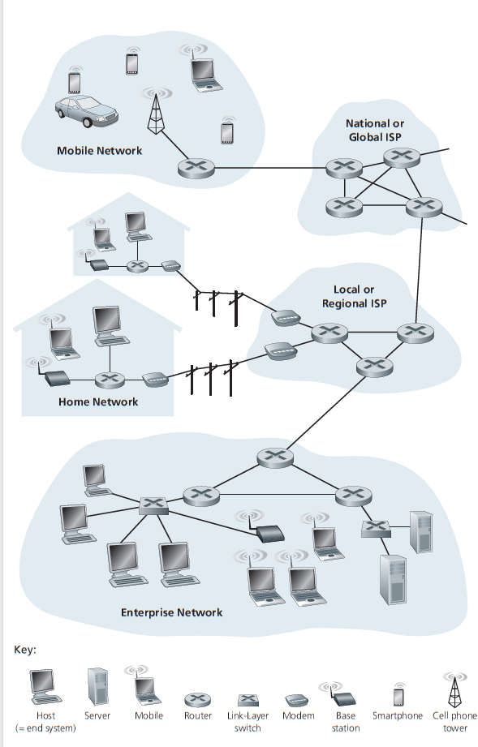
Internet – the bigger picture
Networks
Computer Networks
internetworks
The Internet
Communication Links
End systems / hosts
Switches / routers

Slide 3
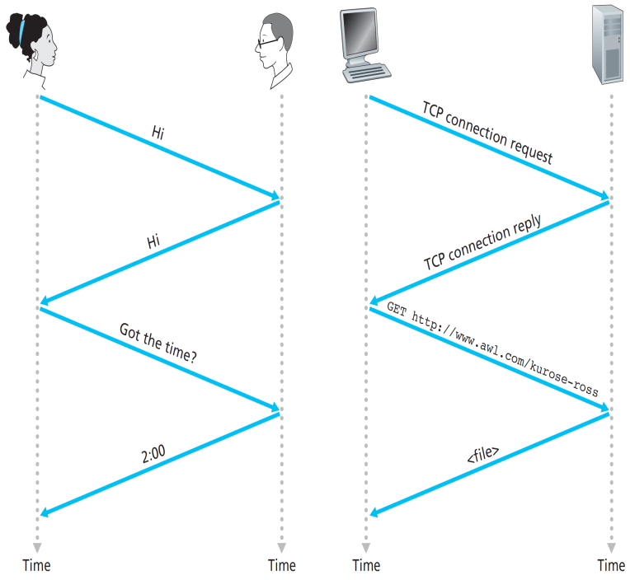
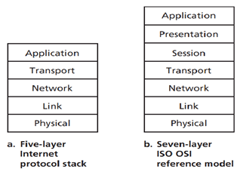
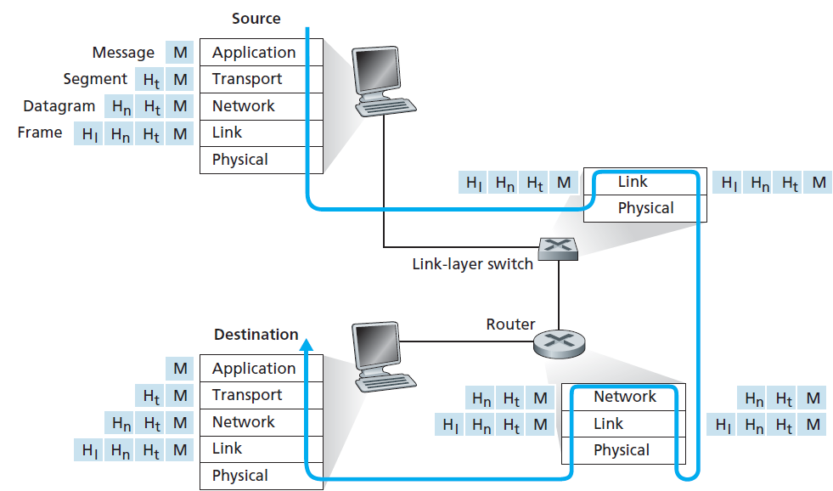
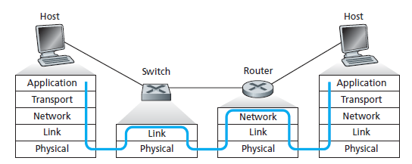
Protocols and Standards

Slide 4
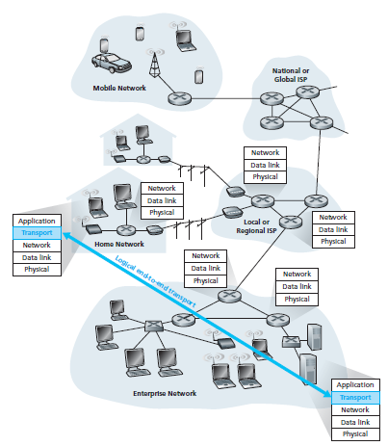
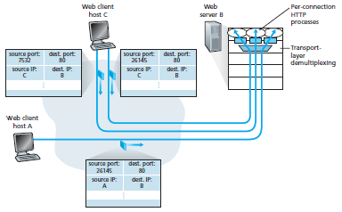
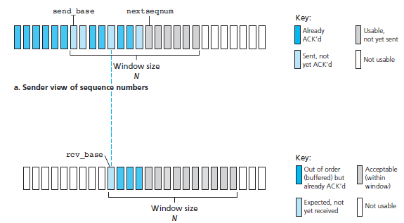
The Transport Layer
Multiplexing / de-multiplexing
Reliability & in-order delivery
Congestion control
Flow Control

Slide 5
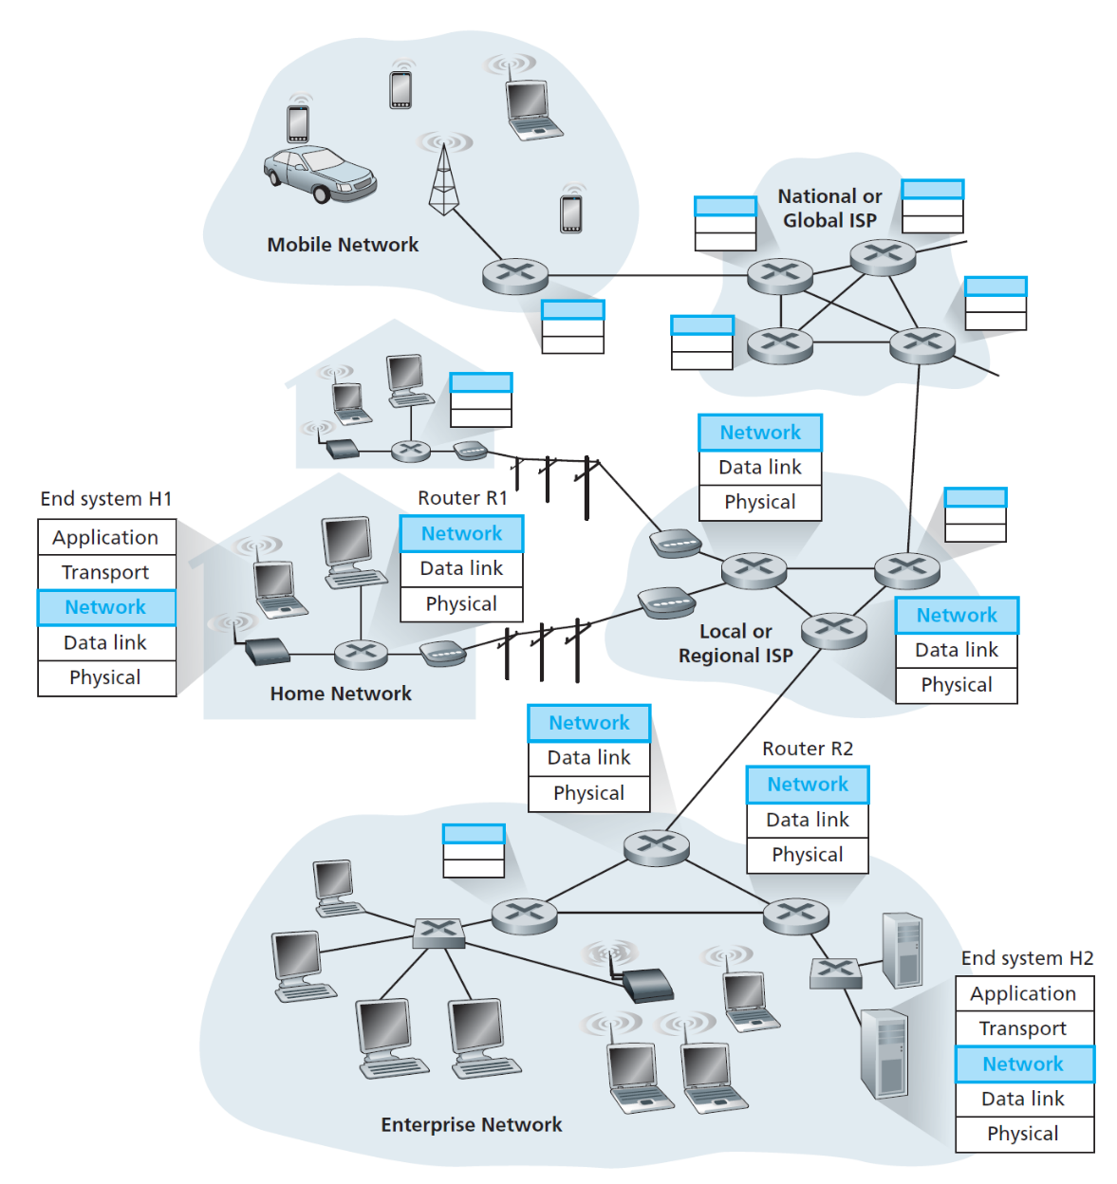
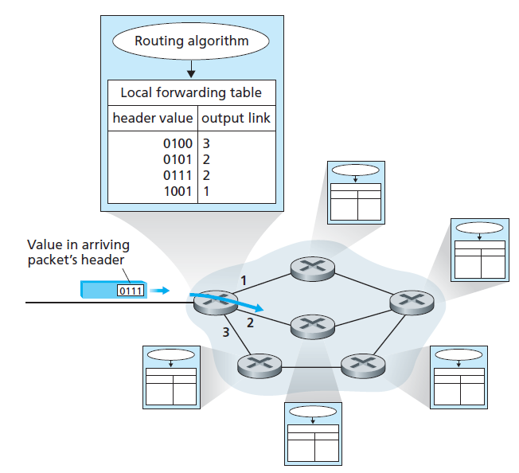
The Network Layer
Routing
Routing Metric
Hop-count, BW
ETX, ETT
Routing Protocol
RIP, OSPF
BGP
Packet Forwarding
QoS

Slide 6
A closer look at network structure

Slide 7

















A closer look at network structure:
network edge:
hosts: clients and servers
servers often in data centers
mobile network
global ISP
home
network
regional ISP
physical media: wired, wireless communication links
network core:
interconnected routers
network of networks
institutional
network

Slide 8


Access networks and physical media
Q: How to connect end systems to edge router?
residential access nets
institutional access networks (school, company)
mobile access networks

Slide 9
Access Networks

Slide 10

Access Networks
Nuts and Bolts of Internet

Slide 11
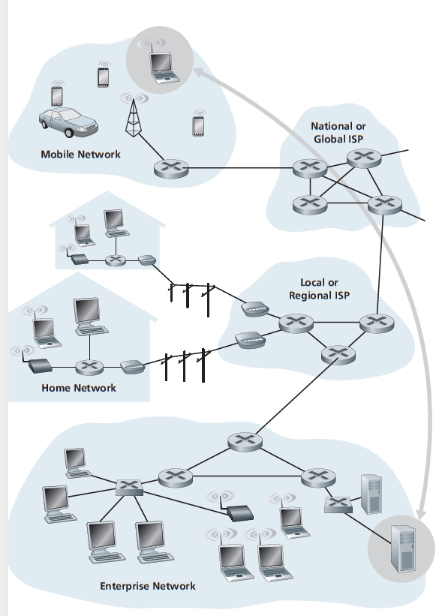
Access Networks
End System Interaction

Slide 12
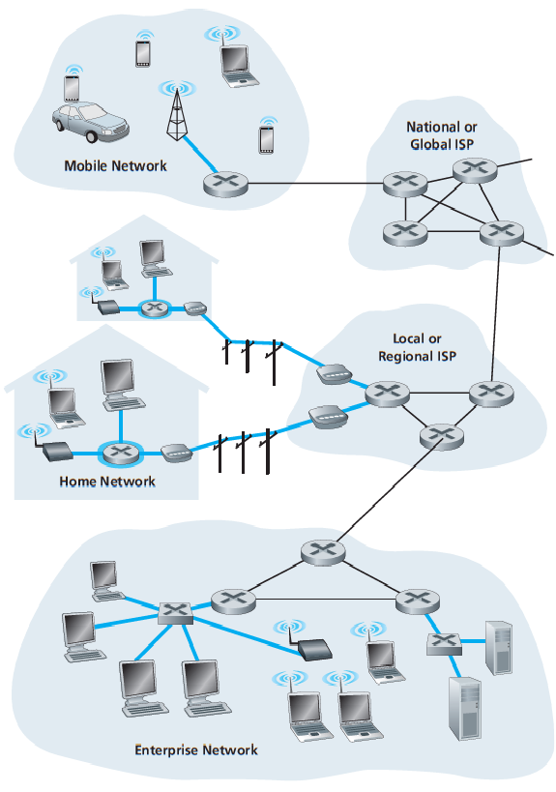
Access Networks
The network that physically connects an end system to the first router (also known as the “edge router”) on a path from the end system to any other distant end system

Slide 13
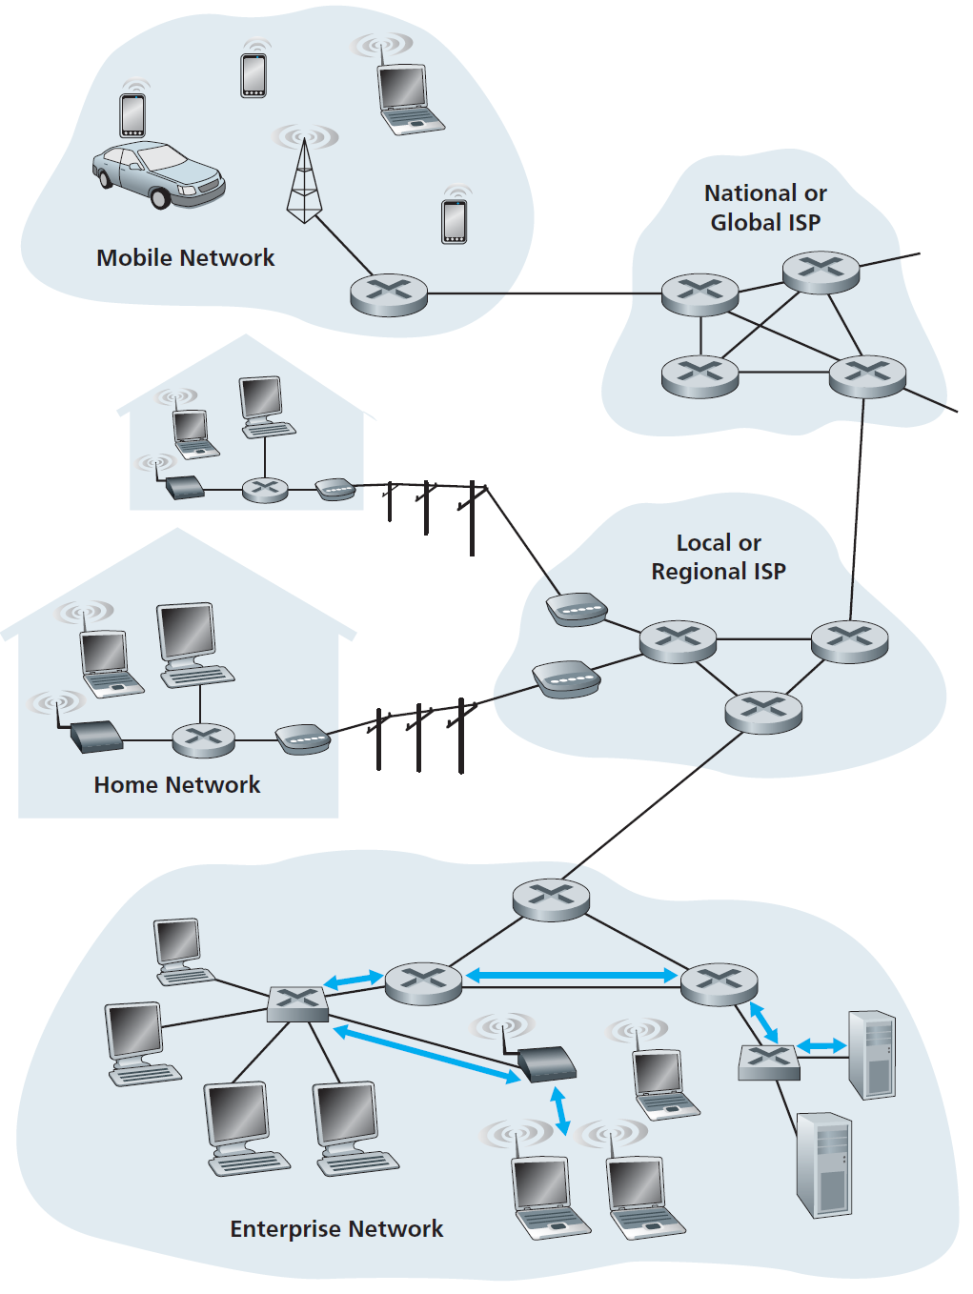
Access Networks Taxonomy based on Technology Used
Access Networks
Ethernet
WiFi-Based Access Networks
Wireless LAN
802.11a/b/g
Ad-hoc Networks
Mesh Networks
DTN/ICN
VANET
6LowPANs
WSNs
WiMAX-Based Access Net
Cellular Networks
3G Cellular Networks and beyond
etc…

Slide 14
Access Networks Taxonomy based on Technology Used
Internet
TCP
Ethernet
Wimax based
Low PAN
Wi-Fi based
Cellular Network
IP
Access Networks
Wireless Lan
Mesh Network
ICN/DTN
VANET
WSN
3G Cellular Data Network
Figure: a taxonomy of access networks (approximate)

Slide 15
Access Networks
Wired Access Networks

Slide 16

Access net: digital subscriber line (DSL)
central office
telephone
network
DSL
modem
splitter
DSLAM
ISP
voice, data transmitted
at different frequencies over
dedicated line to central office
DSL access
multiplexer
use existing telephone line to central office DSLAM
data over DSL phone line goes to Internet
voice over DSL phone line goes to telephone net
< 2.5 Mbps upstream transmission rate (typically < 1 Mbps)
< 24 Mbps downstream transmission rate (typically < 10 Mbps)

Slide 17



Cable Network
cable headend
…
cable
modem
splitter
C
O
N
T
R
O
L
V
I
D
E
O
V
I
D
E
O
V
I
D
E
O
V
I
D
E
O
V
I
D
E
O
V
I
D
E
O
D
A
T
A
D
A
T
A
1
2
3
4
5
6
7
8
9
Channels
frequency division multiplexing: different channels transmitted
in different frequency bands

Slide 18
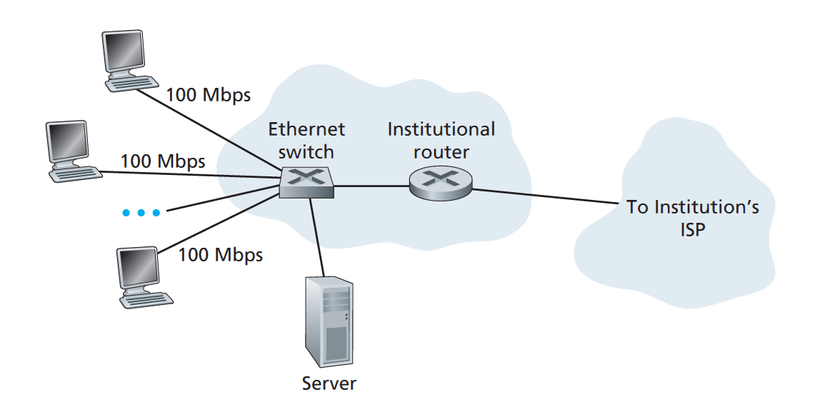
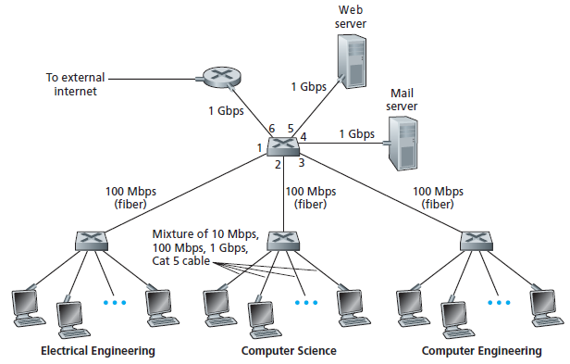
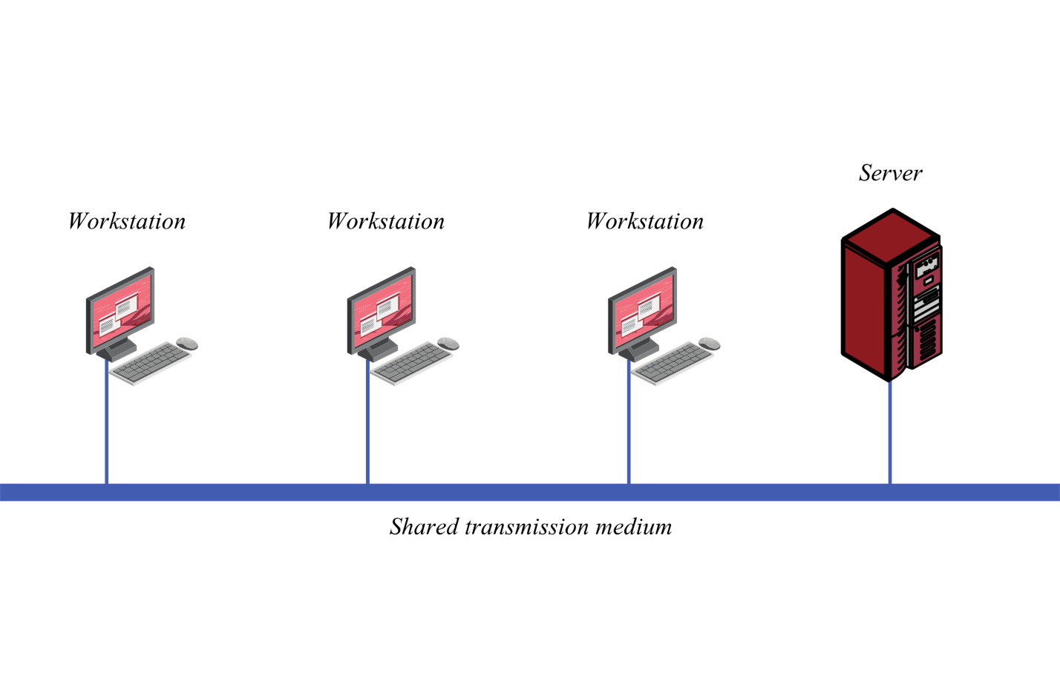
Ethernet – Traditional Wired Access

Slide 19
Access Networks
Wireless Access Networks

Slide 20









Wireless Access Networks
shared wireless access network connects end system to router
via base station aka “access point”
wide-area wireless access
provided by telco (cellular) operator, 10’s km
between 1 and 10 Mbps
3G, 4G: LTE
wireless LANs:
within building (100 ft)
802.11b/g (WiFi): 11, 54 Mbps transmission rate
to Internet
to Internet

Slide 21
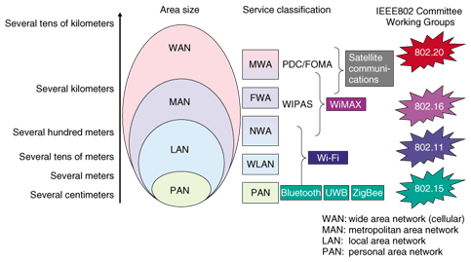
Wireless Access Networks

Slide 22
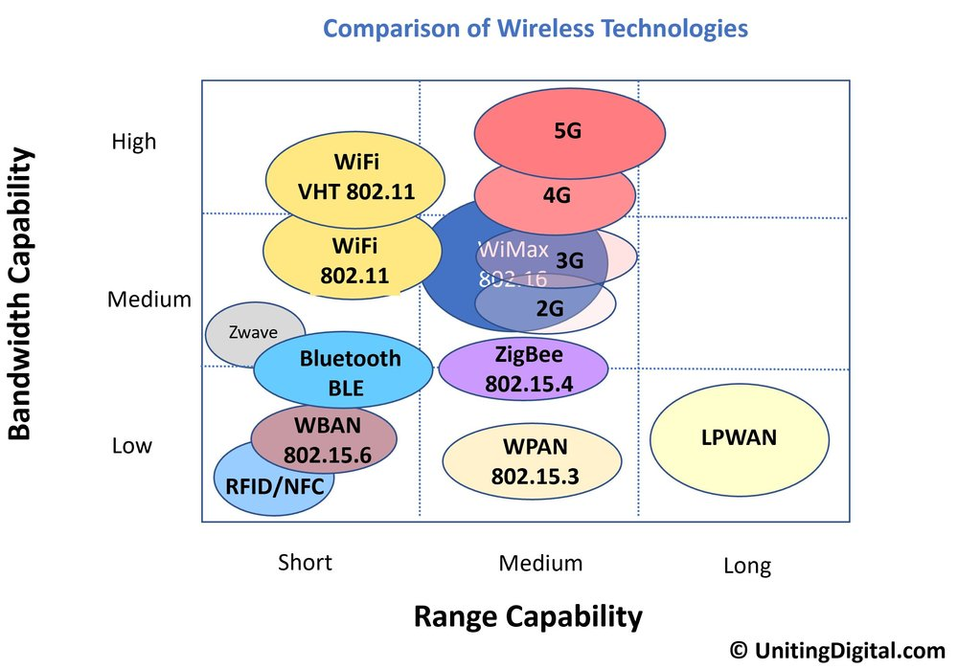
Wireless Access Networks: Range Comparison

Slide 23
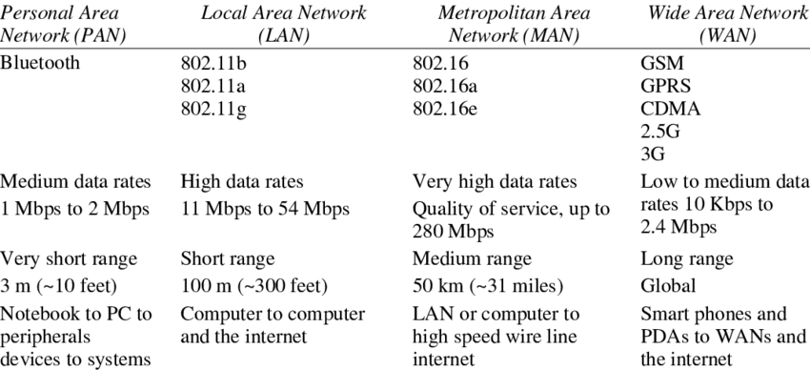
Wireless Access Networks

Slide 24
Milestones in Wireless Communications

Slide 25
Wireless Networks
Ubiquitous Communication Among People and Devices
Wireless Internet access
N^{th} generation Cellular
Wireless Ad Hoc Networks
Sensor Networks
Wireless Entertainment
Smart Homes/Spaces
Automated Highways
All this and more…

Slide 26
Wireless Network: Wireless Link
Wireless link
Typically used to connect mobile(s) to base station
Also used as backbone link
Multiple access protocol coordinates link access
network
infrastructure

Slide 27
Wireless Network: Wireless Hosts
Wireless host
Laptop, PDA, IP phone
Run applications
May be stationary (non-mobile) or mobile
network
infrastructure

Slide 28
Wireless Network: Base Station
Base station
Typically connected to wired network
Relay responsible for sending packets between wired network and wireless host(s) in its “area”
E.g., cell towers, 802.11 access points
network
infrastructure

Slide 29
Wireless Network: Infrastructure
Network infrastructure
Larger network with which a wireless host wants to communicate
Typically a wired network
Provides traditional network services
May not always exist
network
infrastructure

Slide 30
Wireless Access Networks:: Infrastructure Modes Scenario #1: Infrastructure Mode
Infrastructure mode
Base station connects mobiles into wired network
Network provides services (addressing, routing, DNS)
Handoff: mobile changes base station providing connection to wired network
network
infrastructure
Client-server communication

Slide 31
Wireless Access Networks:: Infrastructure Modes Scenario #2: Infrastructure-less (Ad Hoc) Mode
Peer-to-peer communication
Ad hoc mode
No base stations
Nodes can only transmit to other nodes within link coverage
Nodes self-organize and route among themselves

Slide 32
Wireless Access Networks:: Infrastructure Modes
 | Infrastructure-based | Infrastructure-less
Single-hop | Base station connected to larger wired network WiFi based wireless LAN Cellular telephony networks WiMAX | One node coordinates the transmissions of the others Bluetooth Ad-hoc 802.11 (e.g., P2P, WiFi Direct)
Multi-hop | Base station exists Some nodes must relay through other nodes Wireless Mesh Networks | No base station exists Some nodes must relay through others Ad hoc wireless Networks Wireless Sensor Networks Mobile Ad-hoc Networks /Vehicular Ad-hoc Networks Delay Tolerant Networks

Slide 33
Wireless Access Networks:: Infrastructure Modes
 | Infrastructure-based | Infrastructure-less
Single-hop | Base station connected to larger wired network WiFi based wireless LAN Cellular telephony networks WiMAX | One node coordinates the transmissions of the others Bluetooth Ad-hoc 802.11 (e.g., P2P, WiFi Direct)
Multi-hop | Base station exists Some nodes must relay through other nodes Wireless Mesh Networks | No base station exists Some nodes must relay through others Ad hoc wireless Networks Wireless Sensor Networks Mobile Ad-hoc Networks /Vehicular Ad-hoc Networks Delay Tolerant Networks

Slide 34
Wireless Access Networks:: Infrastructure Modes
 | Infrastructure-based | Infrastructure-less
Single-hop | Base station connected to larger wired network WiFi based wireless LAN Cellular telephony networks WiMAX | One node coordinates the transmissions of the others Bluetooth Ad-hoc 802.11 (e.g., P2P, WiFi Direct)
Multi-hop | Base station exists Some nodes must relay through other nodes Wireless Mesh Networks (semi-structured) | No base station exists Some nodes must relay through others Ad hoc wireless Networks Wireless Sensor Networks Mobile Ad-hoc Networks /Vehicular Ad-hoc Networks Delay Tolerant Networks

Slide 35
Wireless Access Networks:: Infrastructure Modes
 | Infrastructure-based | Infrastructure-less
Single-hop | Base station connected to larger wired network WiFi based wireless LAN Cellular telephony networks WiMAX | One node coordinates the transmissions of the others Bluetooth Ad-hoc 802.11 (e.g., P2P, WiFi Direct)
Multi-hop | Base station exists Some nodes must relay through other nodes Wireless Mesh Networks (semi-structured) | No base station exists Some nodes must relay through others Ad hoc wireless Networks Wireless Sensor Networks(Structured / Semi-Structured / Un-Structed :: Depending on Application Nature) Mobile Ad-hoc Networks /Vehicular Ad-hoc Networks Delay Tolerant Networks

Slide 36
Wireless Access Networks
Single-hop Infrastructure-based
Wireless Systems
Single-hop Infrastructure-less
Wireless Systems
1. Cellular Networks
2. Wireless LANs
3. WiMAX
4. Bluetooth
Multi-hop Infrastructure-based
Wireless Systems
Multi-hop Infrastructure-less
Wireless Systems
6. Ad hoc wireless Networks
6.1. Wireless Sensor Networks (Structured / Semi-Structured / Un-Structed :: Depending on Application Nature)
6.2. Vehicular Ad-hoc Networks
6.3. Delay Tolerant Networks
5. Wireless Mesh Networks (semi-structured)

Slide 37


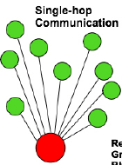
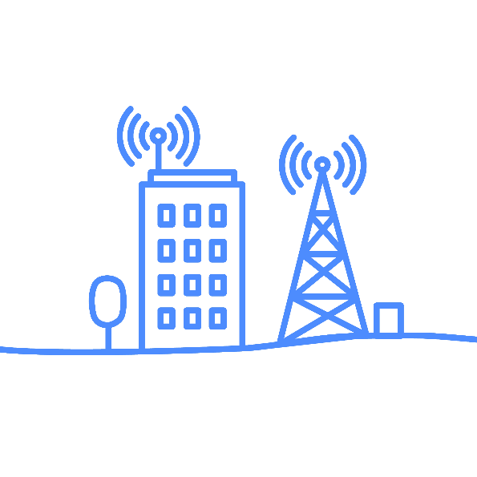
Single-hop Infrastructure-base
Wireless Access Networks
1. Cellular Networks
2. Wireless LANs
3. WiMAX
Notes:
-No backbone: nodes must self-configure into a network.
-In principle all nodes can communicate with all other nodes, but multihop routing can reduce the interference associated with direct transmission.
-Topology dynamic since nodes move around and link characteristics change.
-Applications: appliances and entertainment units in the home, community networks that bypass the Internet. Military networks for robust flexible easily-deployed network (every soldier is a node).

Slide 38
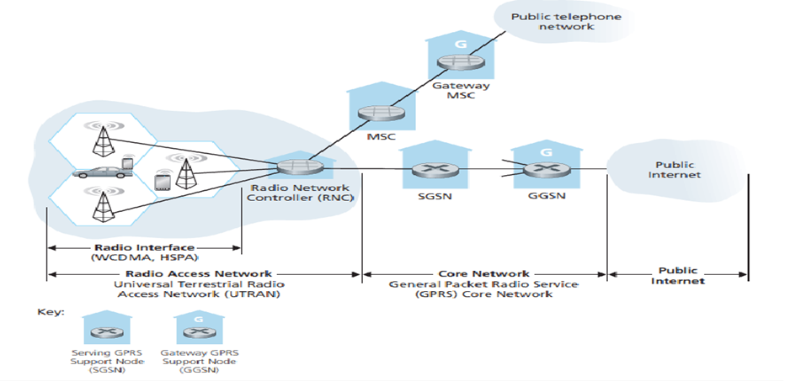
Single-hop Infrastructure-based:: Cellular Networks
3G cellular data network connects radio access networks to the public Internet.
Figure: 3G cellular data network architecture

Slide 39
Cellular Networks: Reuse channels to maximize capacity
Geographic region divided into cells
Frequencies/timeslots/codes reused at spatially-separated locations.
Co-channel interference between same color cells.
Base stations/MTSOs coordinate handoff and control functions
Shrinking cell size increases capacity, as well as networking burden
BASE
STATION
MTSO

Slide 40
Cellular Networks
Santa Barbara
BS
BS
Internet
New York
MTSO
MTSO
PSTN
BS

Slide 41
Cellular Design: Voice and Data
Data is bursty, whereas voice is continuous
Typically require different access and routing strategies
3G “widens the data pipe”:
Standard based on wideband CDMA
Packet-based switching for both voice and data
Evolution of wireless networks:
GSM
IS-95(CDMA)
CDMA 2000 / W-CDMA // IEEE 802.11a/g/b

Slide 42
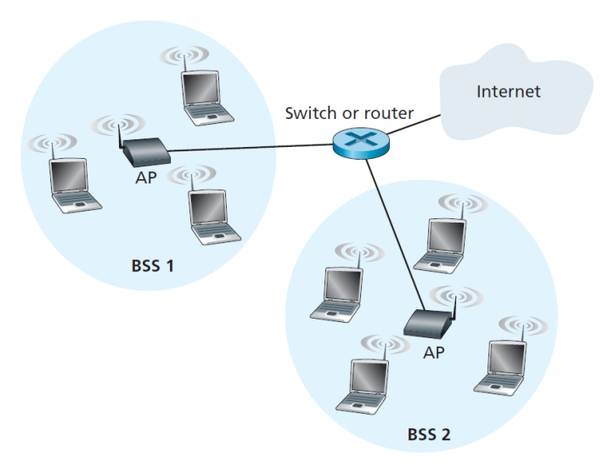
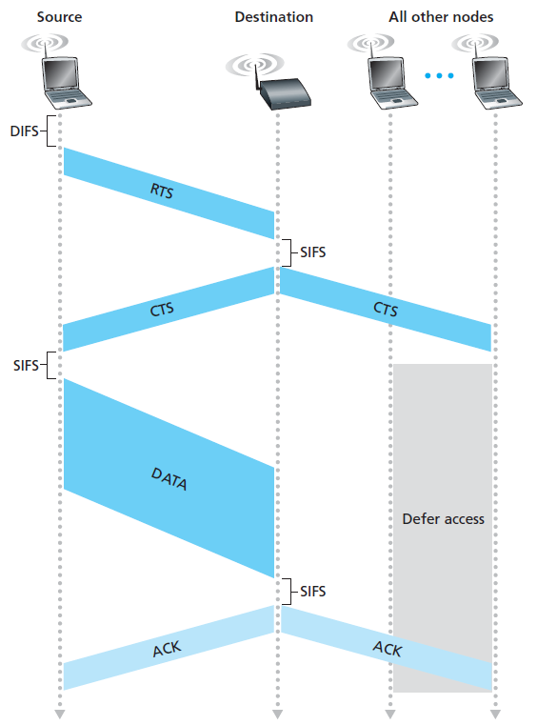
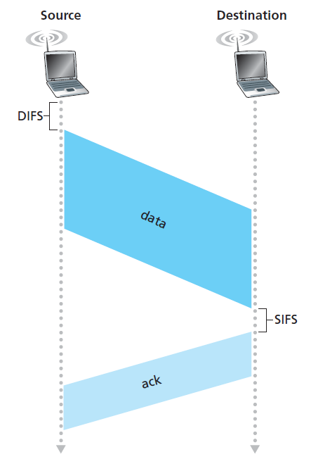
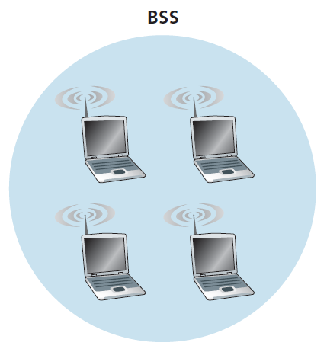
Single-hop Infrastructure-based:: Wireless LANs
Standard | Frequency Range | Data Rate
802.11b | 2.4–2.485 GHz | up to 11 Mbps
802.11a | 5.1–5.8 GHz | up to 54 Mbps
802.11g | 2.4–2.485 GHz | up to 54 Mbps

Slide 43
Single-hop Infrastructure-based:: Wireless LANs
01011011
0101
1011
Internet
Access
Point
WLANs connect “local” computers
Channel access is shared (random access)
Backbone Internet provides best-effort service

Slide 44
Single-hop Infrastructure-based:: Wireless LAN Standards
802.11b
Standard for 2.4GHz ISM band (80 MHz)
Frequency hopped spread spectrum
1.6-10 Mbps, 500 ft range
802.11a
Standard for 5GHz NII band (300 MHz)
OFDM with time division
20-70 Mbps, variable range
Similar to HiperLAN in Europe
802.11g
Standard in 2.4 GHz and 5 GHz bands
OFDM
Speeds up to 54 Mbps

Slide 45
Single-hop Infrastructure-based:: Wireless LAN Standards
Data rate :
IEEE 802.11b: 11 Mbps
IEEE 802.11g: 54 Mbps
IEEE 802.11n (Wi-Fi 4): Up to 600 Mbps
IEEE 802.11ac (Wi-Fi 5): Up to 6.9 Gbps
IEEE 802.11ax (Wi-Fi 6/6E): Up to 9.6 Gbps
IEEE 802.11be (Wi-Fi 7) (emerging): Targeting >30 Gbps

Slide 46
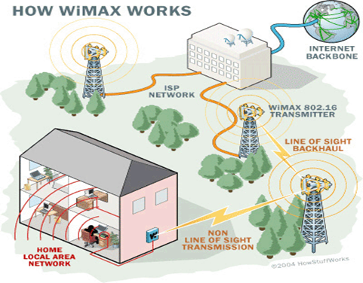
(Worldwide Interoperability for Microwave Access)
Single-hop Infrastructure-based:: WiMAX
A wireless communications standard - designed to provide 30 to 40 megabit-per-second data rates, with the 2011 update providing up to 1 Gbit/s for fixed stations.
It refers to interoperable implementations of the IEEE 802.16 family of wireless-networks standards.
Figure: Working Procedure of WiMAX

Slide 47
Single-hop Infrastructure-based::
WiMAX
Provide portable mobile broadband connectivity across cities and countries
Wireless alternative to cable and digital subscriber line (DSL) for "last mile" broadband access
Provide data, telecommunications (VoIP) and IPTV services (triple play)
A source of Internet connectivity as part of a business continuity plan

Slide 48

Single-hop Infrastructure-less
Wireless Access Networks
4. Bluetooth
Notes:
-No backbone: nodes must self-configure into a network.
-In principle all nodes can communicate with all other nodes, but multihop routing can reduce the interference associated with direct transmission.
-Topology dynamic since nodes move around and link characteristics change.
-Applications: appliances and entertainment units in the home, community networks that bypass the Internet. Military networks for robust flexible easily-deployed network (every soldier is a node).

Slide 49
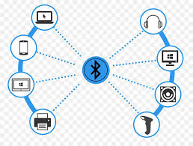
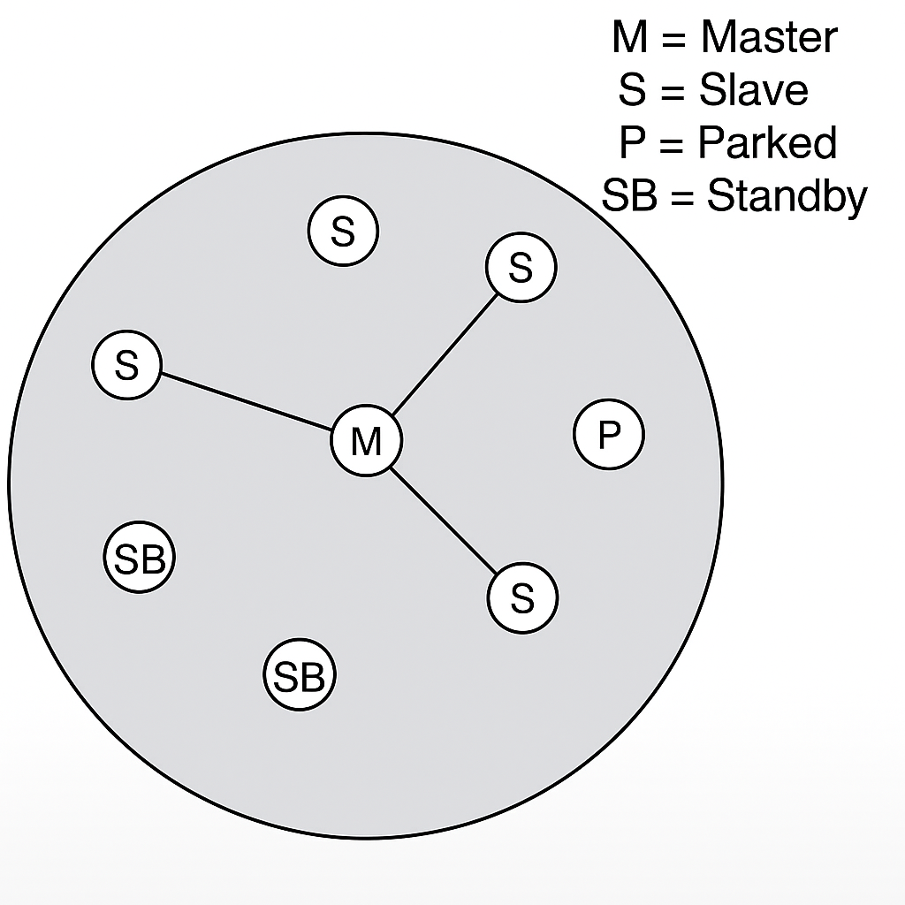
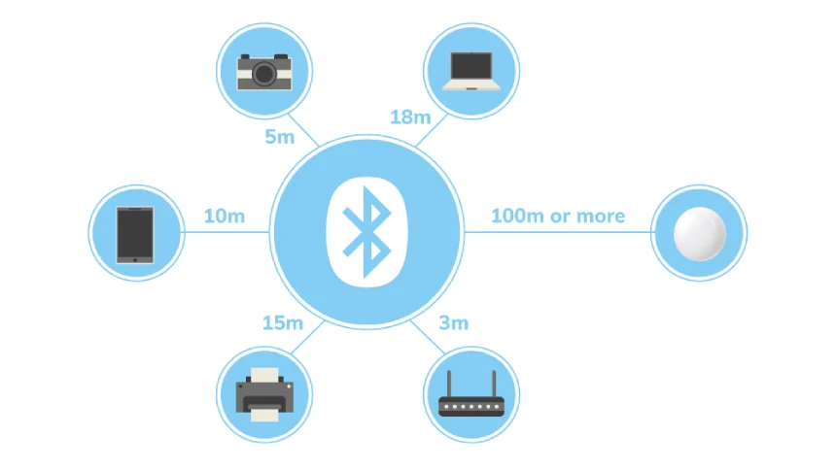
Single-hop Infrastructure-less:: Bluetooth Networks
Piconet
Master – Slave Communication
only the Master can initiate and control communication within a piconet.
Parked Node: Devices are still synchronized with the master but are not actively participating in communication.
Standby Node: Devices are in an idle state, not connected to any piconet.
8C32810.61-Cimini-7/98

Slide 50
Single-hop Infrastructure-less:: Bluetooth Networks
Property | Description
Frequency Band | 2.4 GHz ISM band (2.402 – 2.480 GHz)
Technology | Frequency Hopping Spread Spectrum (FHSS), 1600 hops/sec
Network Topology | Piconet (1 master + up to 7 active slaves)
Data Rate | Up to 721 Kbps (Classic)
Range | ~10 meters (Class 2), up to 100 meters (Class 1)
Roles | Master (initiates & controls communication), Slave (responds to master)
Security | Authentication, Authorization, Encryption
Voice Support | Up to 3 simultaneous SCO voice channels
Device States | Active, Parked, Standby

Slide 51
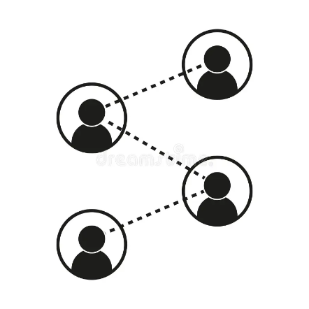
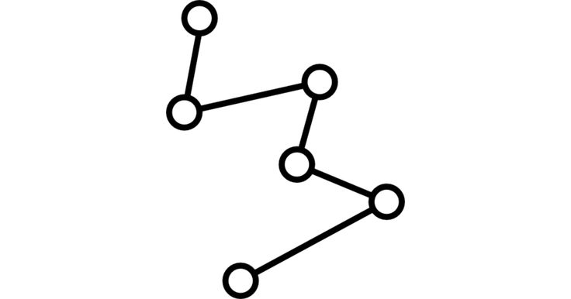
Multi-hop Infrastructure-base
Wireless Access Networks
5. Wireless Mesh Networks (semi-structured)
Notes:
-No backbone: nodes must self-configure into a network.
-In principle all nodes can communicate with all other nodes, but multihop routing can reduce the interference associated with direct transmission.
-Topology dynamic since nodes move around and link characteristics change.
-Applications: appliances and entertainment units in the home, community networks that bypass the Internet. Military networks for robust flexible easily-deployed network (every soldier is a node).

Slide 52
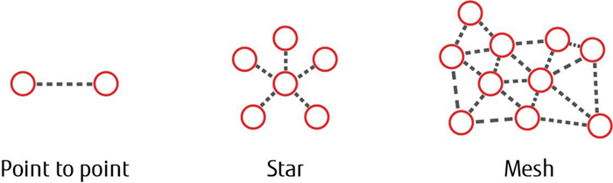
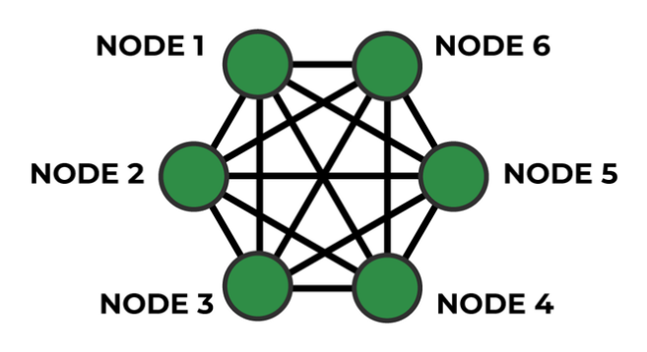
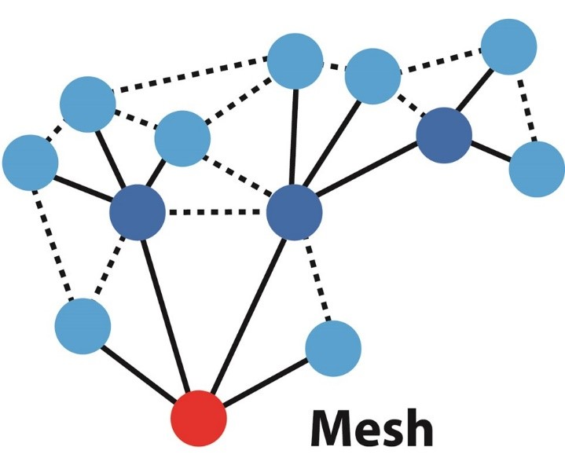
Multi-hop Infrastructure-based:: Wireless Mesh Networks

Slide 53
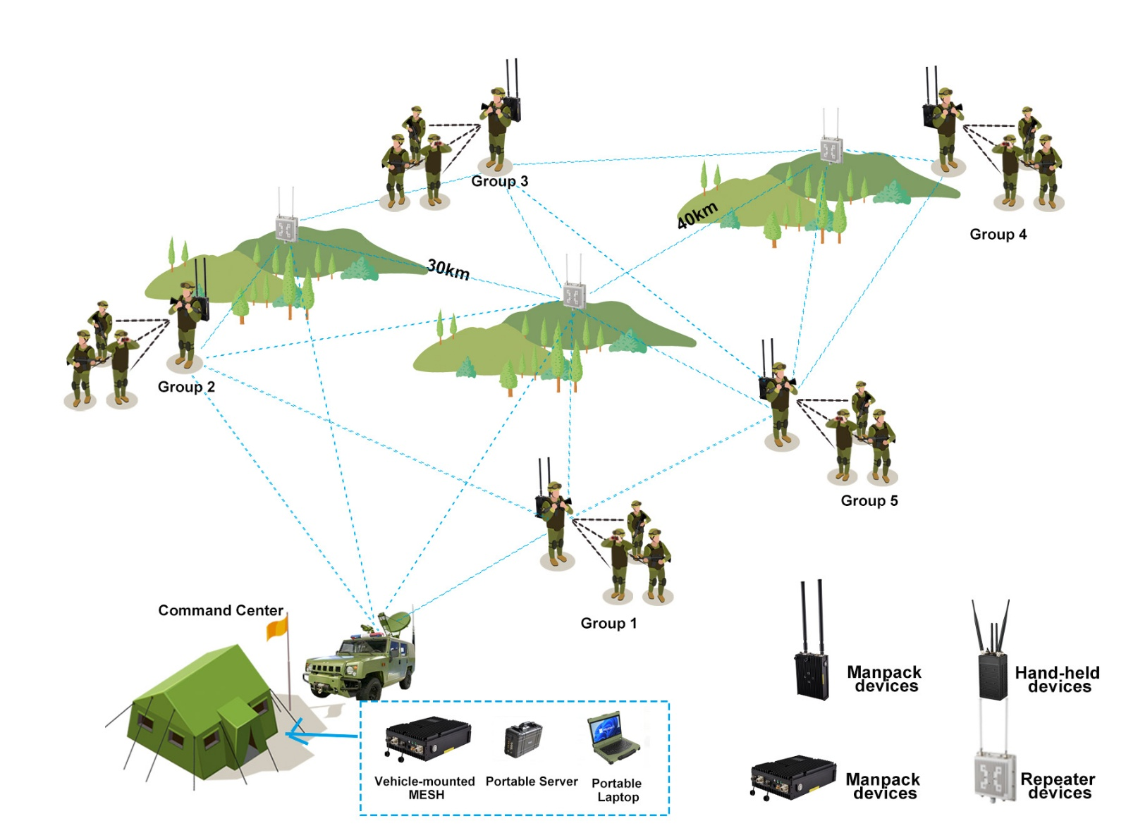
Multi-hop Infrastructure-based:: Wireless Mesh Networks
Application: Military battlefield communication

Slide 54
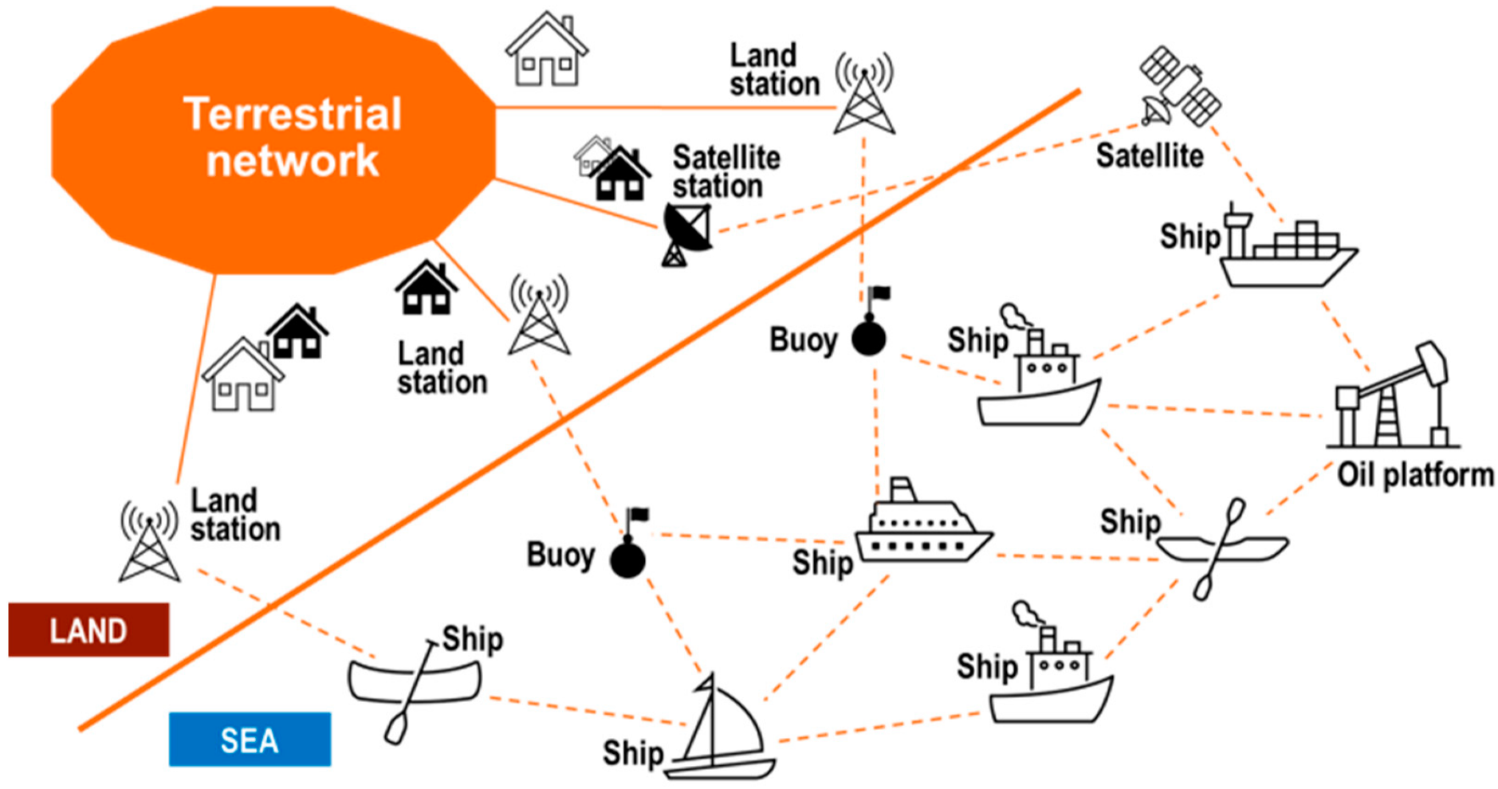
Multi-hop Infrastructure-based:: Wireless Mesh Networks
Application: Maritime Mesh Network

Slide 55
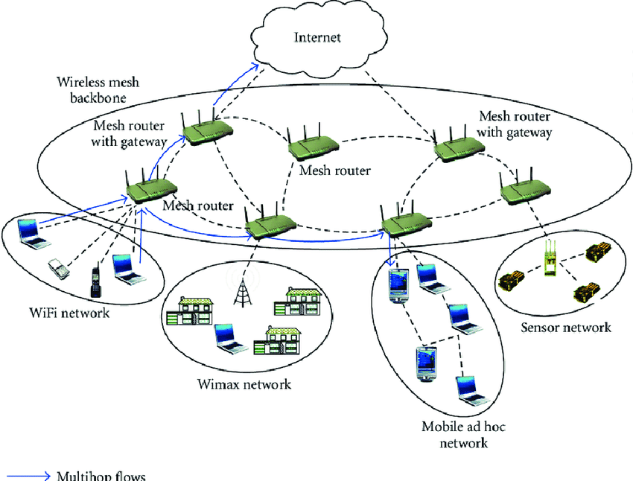
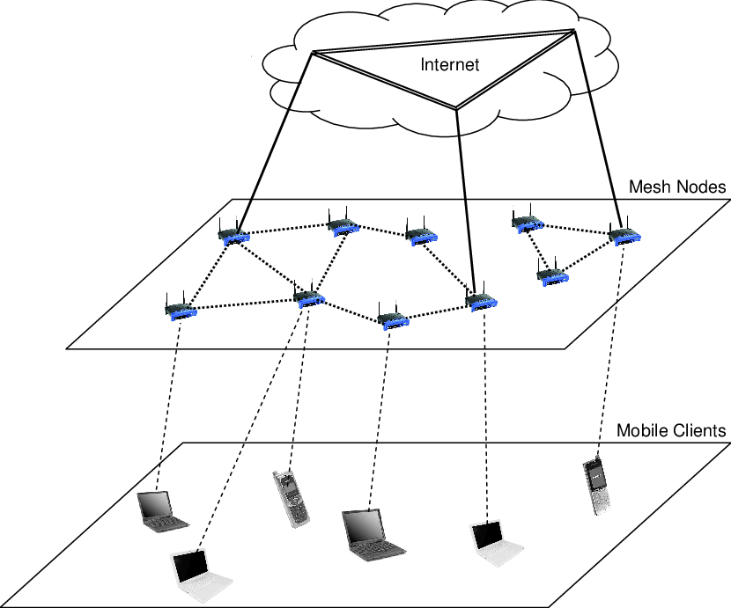
Multi-hop Infrastructure-based:: Wireless Mesh Networks
Application: Hybrid Wireless Mesh Network for Backbone for Community Broadband Connectivity

Slide 56
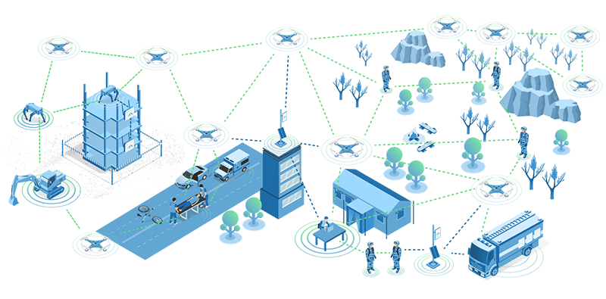
Multi-hop Infrastructure-based:: Wireless Mesh Networks
Application: Drone Mesh Networks (UAV Mesh Networks)

Slide 57

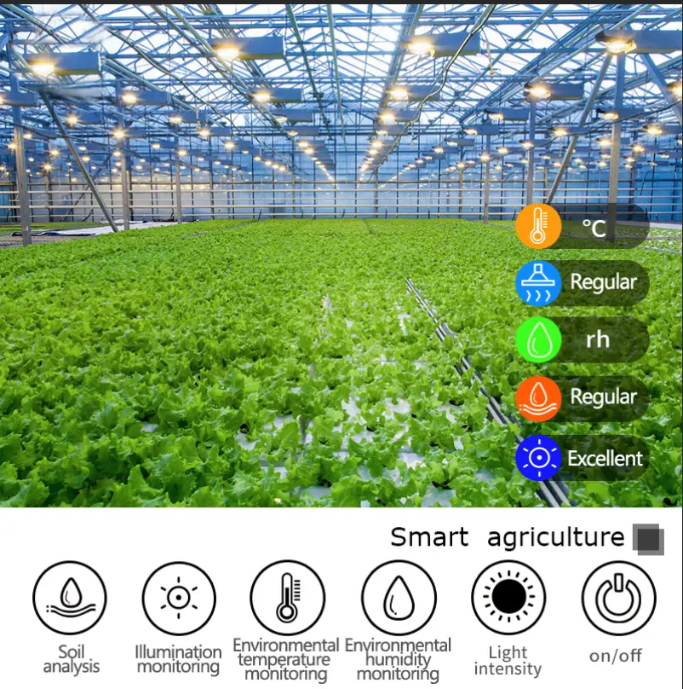
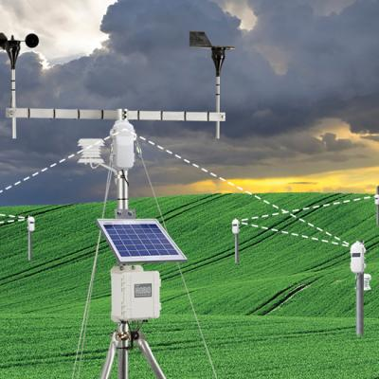
Multi-hop Infrastructure-based:: Wireless Mesh Networks
Application: Very Large-Scale Agricultural Monitoring with Mobile Machineries

Slide 58

Multi-hop Infrastructure-based:: Wireless Mesh Networks
Application: Smart & Connected City with Mobile & Static Devices

Slide 59
Multi-hop Infrastructure-based:: Wireless Mesh Networks
How WMNs Work
1. Network Structure
WMNs consist of two types of devices:
Mesh Routers (MRs):
Fixed nodes that form the backbone of the mesh.
Often connected to the internet.
Mesh Clients (MCs):
End-user devices like laptops, phones, sensors.
Connect to the mesh routers or other clients.
2. Multi-hop Routing
Data travels hop-by-hop through multiple mesh routers to reach its destination.
If a direct path is not available, packets are forwarded through intermediate nodes.
3. Self-Healing Capability
If a node fails or a link breaks, the network automatically reroutes traffic through alternative paths.
Ensures high reliability and robustness.
4. Self-Configuration
New nodes can join the network and start routing without manual configuration.
Each node participates in the routing process and discovers neighbors dynamically.

Slide 60
Multi-hop Infrastructure-based:: Wireless Mesh Networks
📌 Key Features:
Feature | Description
Multi-hop | Increases coverage without requiring all nodes to be in range of each other
Self-healing | Network adapts to failures automatically
Flexible coverage | Nodes can be added easily to expand range
No central controller | Decentralized, peer-based communication

Slide 61
Multi-hop Infrastructure-based:: Wireless Mesh Networks
📌 Key Challenges:
1. Interference and Shared Medium
Problem: Nodes use a shared wireless medium, leading to co-channel interference, hidden terminal, and exposed terminal problems.
Impact: Reduces throughput and increases collisions.
2. Scalability
Problem: As the number of nodes increases, routing overhead and contention grow.
Impact: Performance degrades due to increased latency and reduced bandwidth per node.
3. Dynamic Topology & Routing Complexity Problem: Nodes may join, leave, or move, causing frequent route breaks and topology changes.
Impact: Requires adaptive routing protocols and fast convergence.
4. Limited Bandwidth and Throughput
Problem: Each additional hop in a path reduces available bandwidth due to medium reuse.
Impact: End-to-end throughput suffers, especially in large mesh networks.

Slide 62
Multi-hop Infrastructure-based:: Wireless Mesh Networks
📌 Key Challenges:
5. Security Threats
Problem: WMNs are vulnerable to eavesdropping, spoofing, DoS attacks, and routing attacks.
Impact: Compromises confidentiality, integrity, and availability.
6. Quality of Service (QoS)
Problem: Hard to guarantee latency, jitter, and packet delivery ratio over unreliable, shared wireless links.
Impact: Affects performance of real-time applications like VoIP and video streaming.
7. Synchronization and Coordination
Problem: Distributed nature of WMNs makes scheduling transmissions and synchronizing clocks challenging.
Impact: Causes collisions, inefficient channel use, and poor coordination.
8. Heterogeneity of Devices
Problem: WMNs may include devices with different capabilities, interfaces, and protocols.
Impact: Interoperability issues arise, complicating routing and communication.

Slide 63
Multi-hop Infrastructure-based:: Wireless Mesh Networks
Watch: How do Mesh Networks Works?
Watch: Mesh Networking Idea
Watch: Mesh WiFi Vs. WiFi Extenders

Slide 64
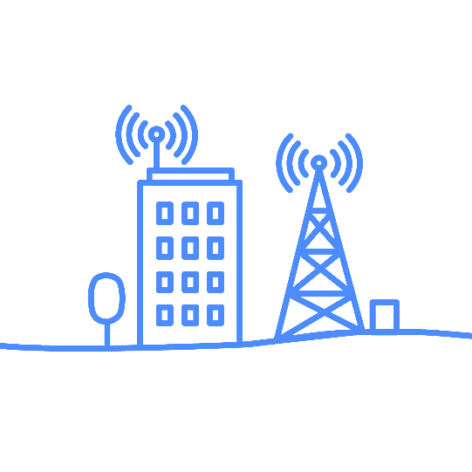
Multi-hop Infrastructure-less
Wireless Access Networks
6. Ad hoc wireless Networks
6.1. Wireless Sensor Networks
6.2. Mobile Ad-hoc Networks /Vehicular Ad-hoc Networks
6.3. Delay Tolerant Networks
Notes:
-No backbone: nodes must self-configure into a network.
-In principle all nodes can communicate with all other nodes, but multihop routing can reduce the interference associated with direct transmission.
-Topology dynamic since nodes move around and link characteristics change.
-Applications: appliances and entertainment units in the home, community networks that bypass the Internet. Military networks for robust flexible easily-deployed network (every soldier is a node).

Slide 65
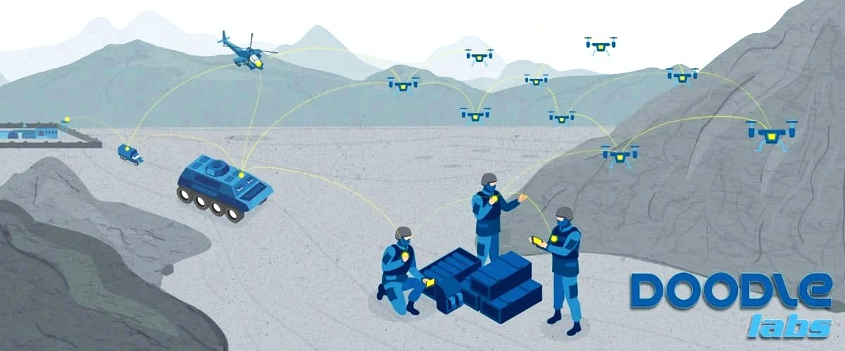
Multi-hop Infrastructure-less:: Wireless Ad-Hoc Networks
Application: Military battlefield communication in Ad-Hoc Mode

Slide 66
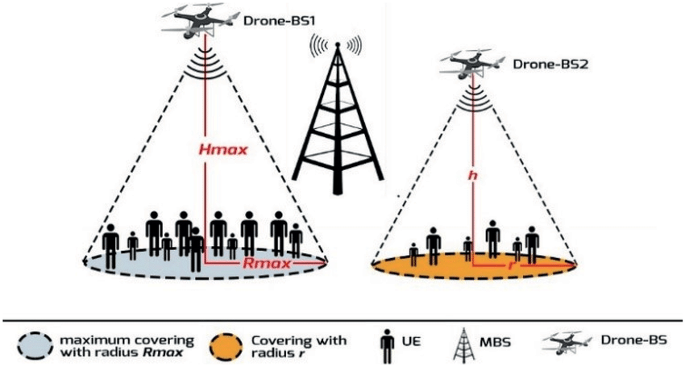
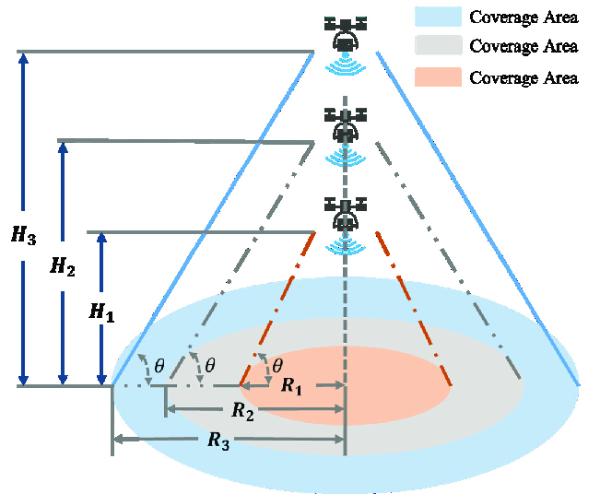
Multi-hop Infrastructure-less:: Wireless Ad-Hoc Networks
Application: Drone Ad-Hoc Networks (UAV Ad-Hoc Networks)
Temporary Internet Coverage
Search and Rescue in Remote Areas
Environmental and Wildlife Monitoring
Disaster Response & Emergency Communications

Slide 67
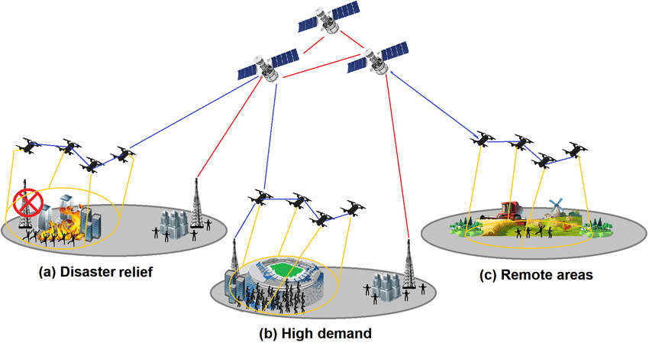


Multi-hop Infrastructure-less:: Wireless Ad-Hoc Networks
Application: Search and Rescue & Emergency Communications in Remote Areas

Slide 68
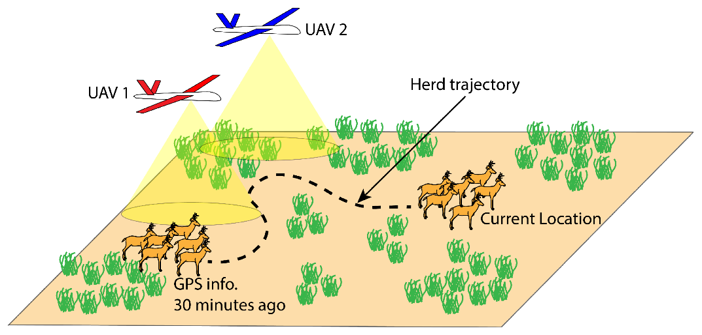

Multi-hop Infrastructure-less:: Wireless Ad-Hoc Networks
Application: Environmental and Wildlife Monitoring

Slide 69
Multi-hop Infrastructure-less:: Ad-Hoc Networks
Peer-to-peer communications.
No backbone infrastructure.
Routing can be multi-hop.
Topology is dynamic.
Fully connected with different link SINRs
Notes:
-No backbone: nodes must self-configure into a network.
-In principle all nodes can communicate with all other nodes, but multihop routing can reduce the interference associated with direct transmission.
-Topology dynamic since nodes move around and link characteristics change.
-Applications: appliances and entertainment units in the home, community networks that bypass the Internet. Military networks for robust flexible easily-deployed network (every soldier is a node).

Slide 70
Multi-hop Infrastructure-less:: Ad-Hoc Networks
Ad-hoc networks provide a flexible network infrastructure for many emerging applications.
The capacity of such networks is generally unknown.
Transmission, access, and routing strategies for ad-hoc networks are generally ad-hoc.
Cross layer design critical are very challenging.
Energy constraints impose interesting design tradeoffs for communication and networking.

Slide 71
Multi-hop Infrastructure-less:: Wireless Mesh Network vs Wireless Ad-Hoc Networks
Aspect | Wireless Mesh Network (WMN) | Wireless Ad-hoc Network (WAHN)
Infrastructure | Semi-infrastructure (uses fixed mesh routers as backbone) | Purely infrastructure-less
Node Roles | Distinct roles: Mesh routers (static) and clients (dynamic) | All nodes are equal; any node can route data
Deployment | Pre-planned, often permanent | Temporary, spontaneous setup
Routing | Stable and optimized (e.g., HWMP, OLSR) | Dynamic and reactive (e.g., AODV, DSR)
Scalability | Highly scalable due to backbone support | Limited scalability due to overhead and congestion
Mobility | Clients may be mobile; routers are often fixed | All nodes may be mobile
Reliability | More reliable due to fixed routers and redundant paths | Less reliable, frequent topology changes
Use Cases | Community networks, smart cities, campus-wide networks | Military ops, disaster relief, emergency response

Slide 72
Multi-hop Infrastructure-less:: Wireless Mesh Network vs Wireless Ad-Hoc Networks
Aspect | Wireless Mesh Network (WMN) | Wireless Ad-hoc Network (WAHN)
Radio Interfaces | Often multi-radio and multi-channel (e.g., 802.11s, WiMAX, LTE) | Usually single-radio, single-channel (e.g., 802.11, Bluetooth)
Backhaul Support | Yes, mesh routers may connect to the Internet or backbone | No backhaul, only peer-to-peer communication
Gateway Capability | Mesh routers often serve as gateways to external networks | No defined gateway; all nodes are peers
Energy Source | Often powered (e.g., fixed routers) | Often battery-operated (mobile nodes)

Slide 73
Multi-hop Infrastructure-less:: Wireless Mesh Network vs Wireless Ad-Hoc Networks
Aspect | Wireless Mesh Network (WMN) | Wireless Ad-hoc Network (WAHN)
Primary Goal | Provide last-mile connectivity and reliable internet access over large areas | Enable peer-to-peer communication in infrastructure-less and mobile environments
Design Focus | Stability, scalability, and long-term connectivity | Quick deployment, flexibility, and dynamic adaptability
Application Focus | Community WiFi, smart cities, industrial IoT, public safety | Military operations, disaster relief, vehicular networks
Traffic Pattern | Typically many-to-one or client-gateway | Dynamic patterns; often all-to-all or many-to-many
Performance Goal | High throughput, fault tolerance, consistent QoS | Fast topology adaptation, minimal delay in dynamic environments

Slide 74
Multi-hop Infrastructure-less:: Wireless Ad-Hoc Networks
6. Ad hoc wireless Networks
6.1. Wireless Sensor Networks
6.2. Mobile Ad-hoc Networks /Vehicular Ad-hoc Networks
6.3. Delay Tolerant Networks
Feature | WSN | VANET | DTN
Infrastructure-less (or minimal) | ✅ | ✅ | ✅
Multi-hop communication | ✅ | ✅ | ✅
Dynamic topology | ✅ (due to node failure/sleep) | ✅ (due to vehicle mobility) | ✅ (due to intermittent connectivity)
Self-organizing | ✅ | ✅ | ✅
Decentralized control | ✅ | ✅ | ✅
Notes:
-No backbone: nodes must self-configure into a network.
-In principle all nodes can communicate with all other nodes, but multihop routing can reduce the interference associated with direct transmission.
-Topology dynamic since nodes move around and link characteristics change.
-Applications: appliances and entertainment units in the home, community networks that bypass the Internet. Military networks for robust flexible easily-deployed network (every soldier is a node).

Slide 75

Wireless Sensor Networks
( Structured / Semi-Structured / Un-Structed :: Depending on Application Nature)
Notes:
-No backbone: nodes must self-configure into a network.
-In principle all nodes can communicate with all other nodes, but multihop routing can reduce the interference associated with direct transmission.
-Topology dynamic since nodes move around and link characteristics change.
-Applications: appliances and entertainment units in the home, community networks that bypass the Internet. Military networks for robust flexible easily-deployed network (every soldier is a node).

Slide 76
Multi-hop Infrastructure-less:: Wireless Sensor Networks
Energy is the primary constraint
Low power Wireless Sensor Network (Low PAN)[IEEE 802.15]
Nodes powered by non rechargeable batteries
Data flows usually to centralized location.
Low per-node rates but up to 100,000 nodes.
Data highly correlated in time and space.
Nodes can cooperate in transmission, reception, compression, and signal processing.

Slide 77
Sensor Networks
Short-range networks must consider transmit, circuit, and processing energy.
Sophisticated techniques not necessarily energy-efficient.
Sleep modes save energy but complicate networking.
Changes everything about the network design:
Delay vs. throughput vs. node/network lifetime tradeoffs.
Optimization of node cooperation.
Notes:
All the sophisticated high-performance communication techniques developed since WW2 may need to be thrown out the window.
By cooperating, nodes can save energy

Slide 78
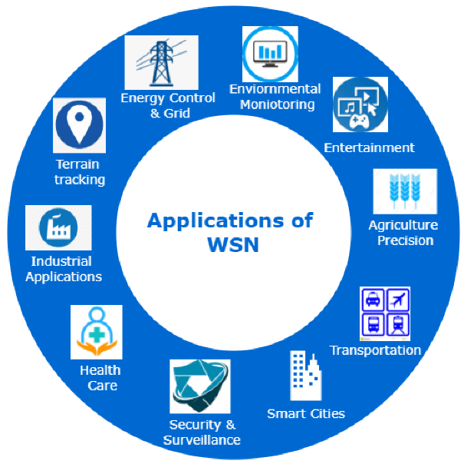
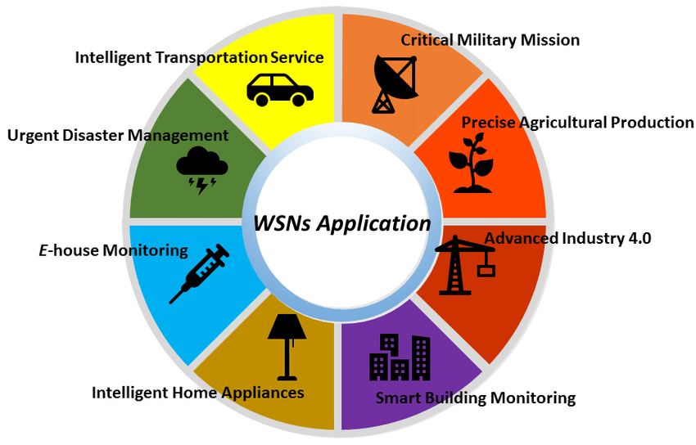
Sensor Networks :: Applications

Slide 79
Sensor Networks :: Applications
Constant monitoring & detection of specific events
Military, battlefield surveillance
Forest fire & flood detection
Habitat exploration of animals
Patient monitoring
Home appliances

Slide 80

Sensor Networks :: Applications
Precision Agriculture: (Structured / Semi-Structured )
Figure: An example of Low PAN Application

Slide 81

Military: (Un-Structured )
Sensor Networks :: Applications
Remote deployment of sensors for tactical monitoring of enemy troop movements.

Slide 82

Smart Home/Smart Office: (Structured)
Sensor Networks :: Applications
Sensors controlling appliances and electrical devices in the house
Better lighting and heating in office buildings

Slide 83

Medical/Biomedical: Body Area Network: (Structured)
Sensor Networks :: Applications
Health Monitors
Glucose
Heart rate
Cancer detection
Chronic Diseases
Artificial retina
Cochlear implants
Hospital Sensors
Monitor vital signs
Record anomalies

Slide 84
Delay/Disruption Tolerant Network (DTN)
(Un-Structed )
Notes:
-No backbone: nodes must self-configure into a network.
-In principle all nodes can communicate with all other nodes, but multihop routing can reduce the interference associated with direct transmission.
-Topology dynamic since nodes move around and link characteristics change.
-Applications: appliances and entertainment units in the home, community networks that bypass the Internet. Military networks for robust flexible easily-deployed network (every soldier is a node).

Slide 85


Interplanetary communication
Delay/Disruption Tolerant Network (DTN)
Notes:
Today’s network applications must communicate across totally different networking environments with different link characteristics. Interplanetary Internet that includes both terrestrial and interplanetary links is an extreme case of DTN. Under water marine communication, sensor networks, satellite communication and etc.

Slide 86

Understanding the TCP and UDP

Slide 87

TCP, UDP and DTN

Slide 88


Delay Tolerant Network (DTN)
Figure:
Figure: Store-And-Forward Message Switching

Slide 89
Delay Tolerant Network
DTN architecture expects nodes to store bundles for an extended period.
Whenever possible, each received data packet is forwarded immediately.
If forwarding is not currently possible but is expected to be possible in the future, the packet is stored for future transmission.
Figure: Store-And-Forward Message Switching

Slide 90

Delay Tolerant Network
Figure:
Figure: Store-And-Forward Message Switching

Slide 91

Mobile-enabled delay tolerant networking in rural developing regions
Delay Tolerant Network (DTN):: Applications
Notes:
Today’s network applications must communicate across totally different networking environments with different link characteristics. Interplanetary Internet that includes both terrestrial and interplanetary links is an extreme case of DTN. Under water marine communication, sensor networks, satellite communication and etc.

Slide 92

Delay Tolerant Network (DTN):: Applications
Notes:
Application is using mobile computation for real biological research using sensors installed on real zebras.
ZebraNet is a power-aware wireless ad hoc sensor network,
the goal is to use systems to perform novel studies of animal migrations and inter-species interactions.

Slide 93



ZebraNet (a real life application)
Delay Tolerant Network (DTN):: Applications
Tracking node with CPU, FLASH, radio and GPS
Data
Store-and-forward communications
Data
Data
Data
First deployment in 2004 in Kenya
Notes:
Application is using mobile computation for real biological research using sensors installed on real zebras.
ZebraNet is a power-aware wireless ad hoc sensor network,
the goal is to use systems to perform novel studies of animal migrations and inter-species interactions.

Slide 94
Satellite Systems
Delay Tolerant Network (DTN):: Applications
Cover very large areas
Different orbit heights
GEOs (39000 Km) versus LEOs (2000 Km)
Optimized for one-way transmission
Radio (XM, DAB) and movie (SatTV) broadcasting

Slide 95
DTN :: Characteristics
Internet environment
End-to-end RTT is not large.
Some path exists between endpoints.
E2E reliability using ARQ works well.
Packet-switching is the right abstraction.
DTN characteristics
Very large delays.
Intermittent and scheduled links.
Different network architectures.
Conversational protocols fail.
No ARQ.

Slide 96
DTN :: Challenges
Applications assume e2e ‘connections’
Routing does not understand schedules
Long-term disconnection causes failures
End-to-end reliability is poor with high loss rates
E2E performance is poor with high delays

Slide 97
Vehicular Ad-hoc Networks
(Un-Structed )
Notes:
-No backbone: nodes must self-configure into a network.
-In principle all nodes can communicate with all other nodes, but multihop routing can reduce the interference associated with direct transmission.
-Topology dynamic since nodes move around and link characteristics change.
-Applications: appliances and entertainment units in the home, community networks that bypass the Internet. Military networks for robust flexible easily-deployed network (every soldier is a node).

Slide 98
Vehicular Ad-hoc Networks
VANET
a form of Mobile ad-hoc network
provide communication
- among nearby vehicles
- nearby fixed equipment

Slide 99


Vehicular Ad-hoc Networks
How vehicular communications work:
Road-Side infrastructure Units (RSUs), are equipped with on-board processing and wireless communication modules

Slide 100

Vehicular Ad-hoc Networks
How vehicular communications work:
Vehicle-to-Vehicle (V2V)
Vehicle-to-Infrastructure (V2I) communication will be possible

Slide 101

Car-to-X (C2X) Communication Patterns
Vehicle-to-X (V2X)/ Car-to-X (C2X),
Inter-Vehicle Communication (IVC),
Vehicular ad-hoc network (VANET),
…
… to car
… to infrastructure
… to home
Illustration: ETSI

Slide 102

Car-to-X (C2X) Communication

Slide 103

Intelligent Transportation Systems (ITS)

Slide 104

Intelligent Transportation Systems (ITS)

Slide 105
Intelligent Transportation Systems (ITS)
What can ITS provide ?
Safety
Efficiency
Traffic and road conditions
Road signal alarm
Local information

Slide 106
Intelligent Transportation Systems (ITS)
Few Emerging Applications that ITS provide ?
Autonomous Intersection Management (AIM)
Vehicle Platooning for Fuel and Space Efficiency
Eco-Driving and Green Routing
Cooperative Perception and Safety Sharing
Autonomous On-Demand Public Transit (Dynamic ride-pooling)
Automated Smart Parking
Real-Time Traffic Prediction and Control
Cooperative Highway Merging and Lane Changing
Dynamic Speed and Lane Recommendations

Slide 107

Car-to-X (C2X) Communication
Autonomous Intersection Management (AIM):
However, future AIM will adhere Strictly to Fundamental Traffic Rules, Prioritizing Safety as the Top Priority without Human Intervention

Slide 108








Car-to-X (C2X) Communication
Autonomous Intersection Management (AIM):
Replaces traffic lights with autonomous intersection control, where Connected and Autonomous Vehicles (CAVs) communicate with a central coordinator to avoid collisions.
Benefits:
Minimal vehicle waiting time
Reduced fuel consumption and emissions
Elimination of signal delays
Improved intersection throughput
Enhanced safety
Research Extensions:
Robustness to Communication Delays and Packet Loss
Human-Driven Vehicle (HDV) and CAV Coexistence Models
Integration with Eco-Driving Strategies
Scalability in High-Density Urban Grids

Slide 109



Cooperative Perception and Safety Sharing Warning!!
Car-to-X (C2X) Communication
What can Car-to-X (C2X) communication provide ?

Slide 110

Warnings!!! Incident Detection and Reporting
Car-to-X (C2X) Communication
What can Car-to-X (C2X) communication provide ?

Slide 111

Vehicle Platooning :: Eco-Driving
Car-to-X (C2X) Communication
What can Car-to-X (C2X) communication provide ?

Slide 112

Vehicle-to-Vehicle (V2V) Communication
Vehicle-to-Vehicle (V2V) communication enables direct wireless data exchange between vehicles, allowing them to share real-time information such as position, speed, and braking status.
Vehicle Platooning:: Eco-Driving
Faster and more synchronized braking response
enhancing safety
enabling closer following distances
improving traffic flow efficiency

Slide 113
Vehicle-to-Vehicle (V2V) Communication
Manual Driving:
Depends on human perception and reaction.
Causes significant brake lag and larger following distances.
Radar-Based Systems:
Uses sensors to detect deceleration.
Reduces reaction time but still has processing delays.
V2V-Based Platooning:
Shares braking information wirelessly and instantly.
Enables simultaneous braking, minimizing brake lag and allowing closer spacing.
Vehicle-to-Vehicle (V2V) communication enhances emergency braking in truck platooning by enabling faster and synchronized braking responses across all vehicles, improving both safety and traffic flow efficiency compared to traditional systems.

Slide 114

Vehicle Platooning for Improved Fuel Efficiency through Reduced Aerodynamic Drag
Vehicle-to-Vehicle (V2V) Communication
What can V2V communication provide ?

Slide 115


Vehicle-to-Vehicle (V2V) Communication
What can V2V communication provide ?
Vehicle Platooning for Improved Fuel Efficiency through Reduced Aerodynamic Drag

Slide 116


Car-to-X (C2X) Communication
What can Car-to-X (C2X) communication provide ?
Intelligent Traffic Flow Management

Slide 117


Road Traffic Accidents Avoidance
Car-to-X (C2X) Communication
What can Car-to-X (C2X) communication provide ?

Slide 118



Pedestrian and Cyclist Protection
Car-to-X (C2X) Communication
What can Car-to-X (C2X) communication provide ?

Slide 119
Car-to-X (C2X) Communication:: Taxonomy of Use Cases
Vehicle-to-X
Non-Safety
Safety
Adaptive Cruise Control
Comfort
Blind Spot Warning
Warning Messages
Electronic Brake Light
Traffic Information Systems
Optimal Speed Advisory
Situation Awareness
Contextual Information
Traffic Light Violation
Entertainment
Congestion, Accident Information

Slide 120
Car-to-X (C2X) Communication:: Taxonomy of Use Cases
Non-Safety
Safety
Vehicle-to-X
Many messages
High data rate
Few messages
Small packet size
Low latency demands
Low reliability demands
High latency demands
High reliability demands

Slide 121
Challenges of C2X Communication
Communication
Highly varying channel conditions
Tightly limited channel capacity
Networking
Unidirectional Links
Mobility
Multi-Radio / Multi-Network
But: predictable mobility
Security
No (or no reliable) uplink to central infrastructure
Highly dynamic topology
Heterogeneous equipment
Heterogeneous user base
Ensuring privacy
High congestion, contention, interference
Heterogeneous environment

Slide 122


Distributed Control over Wireless Links
Automated Vehicles
- Cars
- UAVs(Unmanned Aerial Vehicles)
- Insect flyers
Packet loss and/or delays impacts controller performance.
Controller design should be robust to network faults.
Joint application and communication network design.

Slide 123
Thank You

